Slide 1
SC1015 Mini Project
Lee Haoguang
Lee Rou Yin
Li Lin
Lab Group: SC2

Slide 2
01
02
03
04
Introduction
Initial Insights
Core Analysis
Conclusion
Notes:
First 2 minutes (approx.) of your presentation -- Your Motivation
You MUST mention which dataset(s) you used, and what EXACTLY is your problem definition.
This is your chance to explain your MOTIVATION. Don't get carried away; be precise and clear.
Next 3 minutes (approx.) of your presentation -- Set The Stage
Present your Exploratory Data Analysis and some initial data-driven Insights from the dataset.
You MAY also mention how you are planning to set up the Analysis / ML problem for this case.
You MUST mention how you collected / curated / cleaned / prepared the data for this problem.
Did you only use tools and techniques learned in this course? What ELSE did you learn / try?
Next 3 minutes (approx.) of your presentation -- Core Analysis
If you used ML (regression, classification, or something else); mention mainly WHICH one(s).
You may now briefly CLARIFY why and how the ML problem(s) aim(s) to solve your objective.
How did you apply ML technique(s) to SOLVE your problem? Which model(s), how and why?
Did you only use tools and techniques learned in this course? What ELSE did you learn / try?
Last 2 minutes (approx.) of your presentation -- Finish Strong
What is the OUTCOME of your project? Did it solve your original problem? Anything interesting?
What are your data-driven INSIGHTS and recommendations / views towards the target problem?

Slide 3

01
Project Introduction
(Amsterdam)
Notes:
intro to database used
kaggle dataset: airbnb Amsterdam

Slide 4
Practical Motivation
2 primary stakeholders
Guests & Hosts
While we often think about how we can choose the best property as a guest, what about offering the best property as a host?
Notes:
motivation behind project
Airbnb is an online marketplace that connects hosts who are looking to rent out their homes with guests looking for a place to stay. We recognised that this platform works 2-ways - both guests and hosts must benefit from it for it to work out.
While we regularly think about how we, as guests can maximise our utility and choose the most "worth-it" property, we wanted to consider another perspective - that is, how do hosts maximise their utility as well when offering their property to others?
we wanted to help airbnb hosts make the most of their property by providing some insights. we formulated the questions:

Slide 5
Questions for Analysis
How does an airbnb host maximise their property?
Sub-questions:
What is a reasonable rent for a particular listing?
Where is the ideal area for listings?
What factors affect the number of bookings?
What ratings would a particular listing get?
Notes:
purpose of project
Main question: How does a airbnb host maximise their property?
Sub questions:
What is a reasonable rent for a particular listing?
Firstly, we want to find out what a reasonable rent is for any particular listing, based on certain variables we identified. This will allow a host to be more knowledgeable about what rent to offer
Where is the ideal area for listings?
We noticed that there were a number of neighbourhoods in the region we chose, with some having more listings than others. (can move this to behind EDA also) we hence wanted to know what the ideal area for a host to put up a listing was.
What factors will affect the number of bookings?
we used number of bookings to approximate the popularity of a listing. We wanted to identify characteristics of popular listings so that a potential host can offer them as well.
What ratings would the listing get?
Why ratings? ratings are something that guests look at closely when choosing a property to rent. It is hence important for the host to keep their ratings up. We want to explore what ratings would get based on its characteristics.

Slide 6
02
Initial Insights
Exploratory Data Analysis & Data Preparation
Notes:
Let's cut the number of slides here
what we did exactly isnt important: more important is why
shld be analysis of whatever is here - no need include everything in the jupyter nb

Slide 7
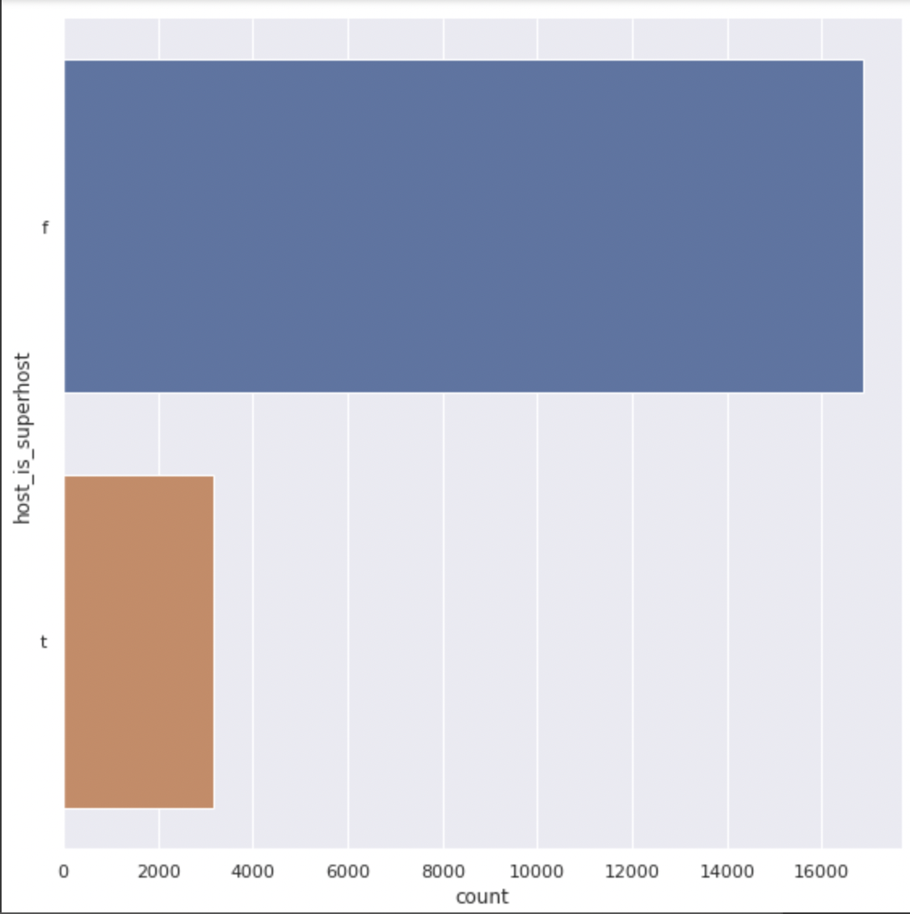

Exploratory Data Analysis - Number of Superhosts
Superhost
Notes:
we found that the number of Superhost is only around 15% of all hosts.

Slide 8
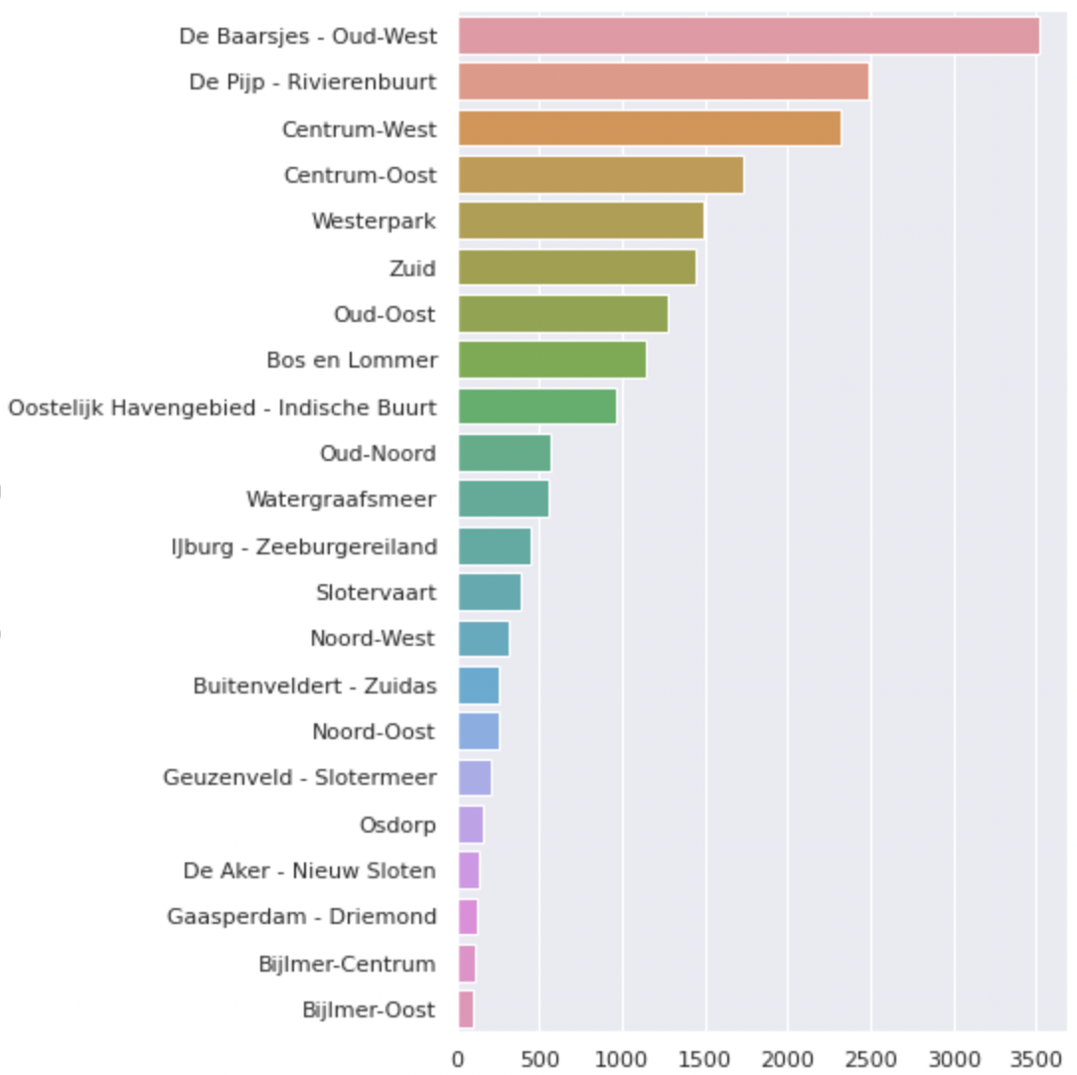
Exploratory Data Analysis - Neighbourhoods

Slide 9
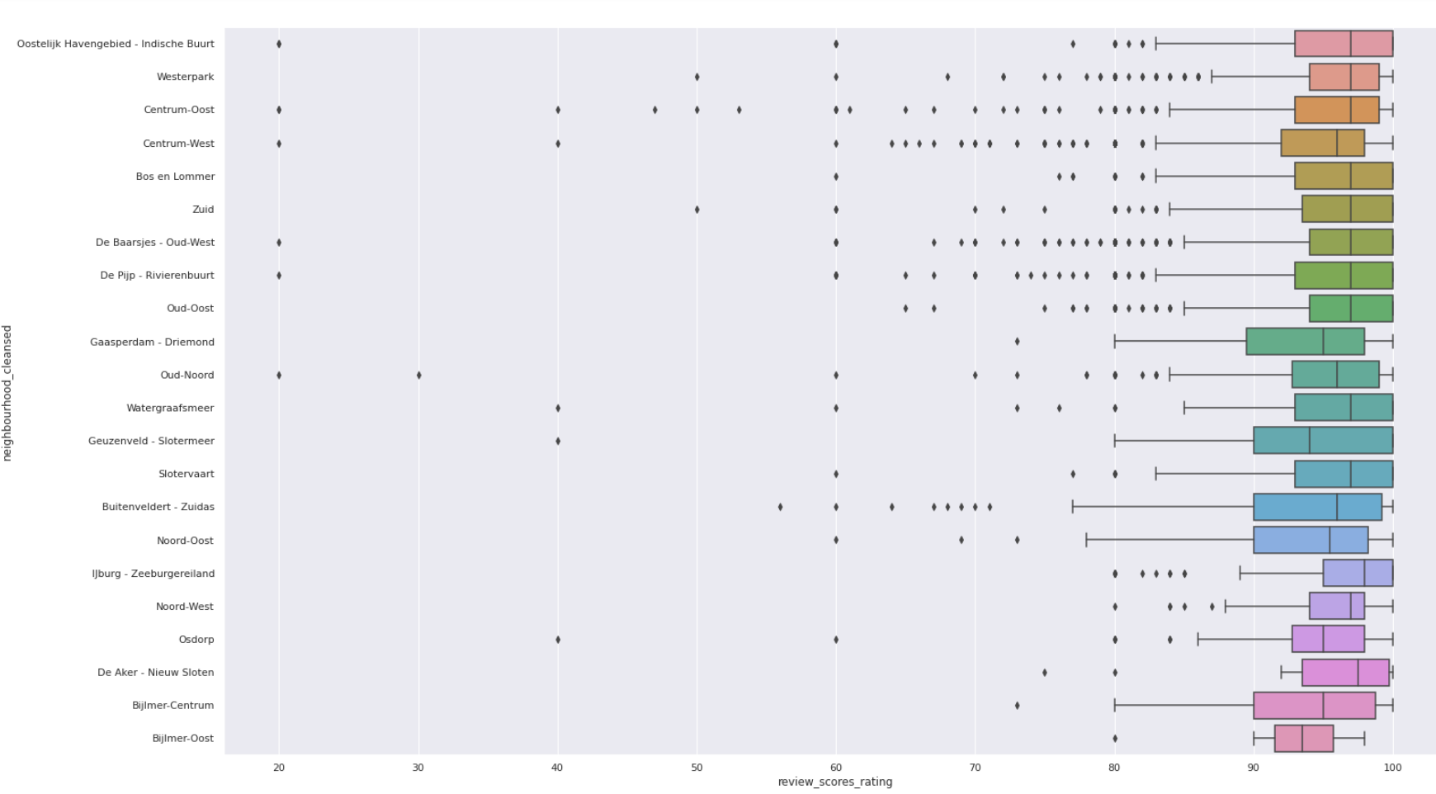
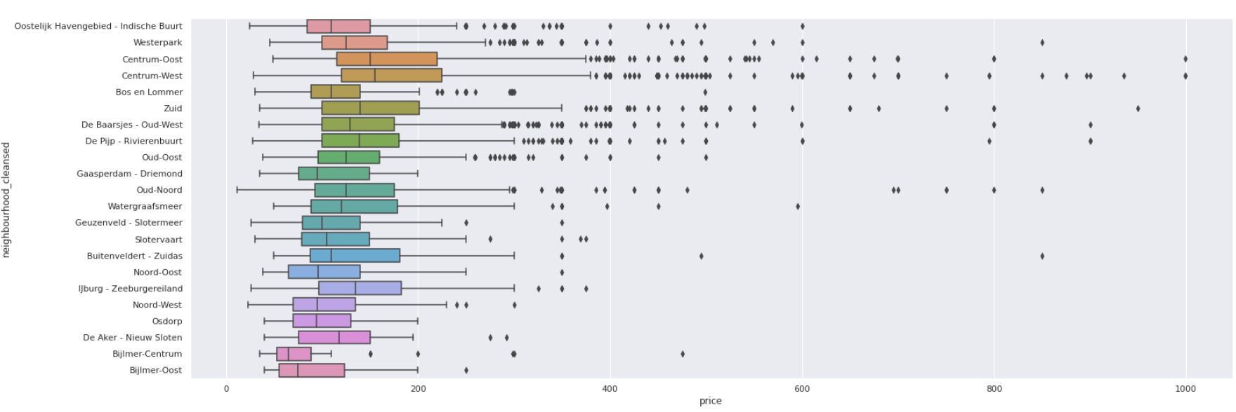
ratings
Price

Slide 10
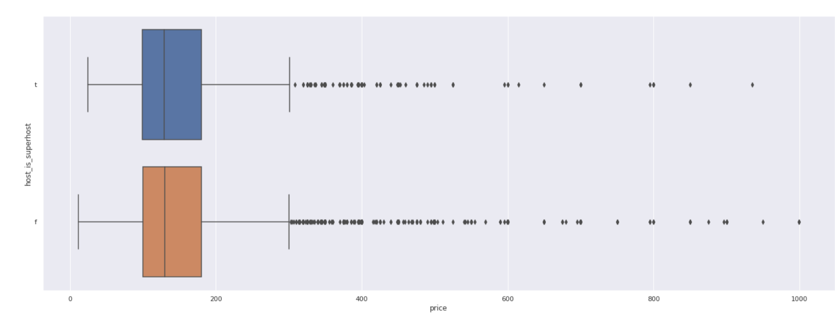
Exploratory Data Analysis - Price

Slide 11
Data Preparation
All Data
Numeric
Categorical

Slide 12
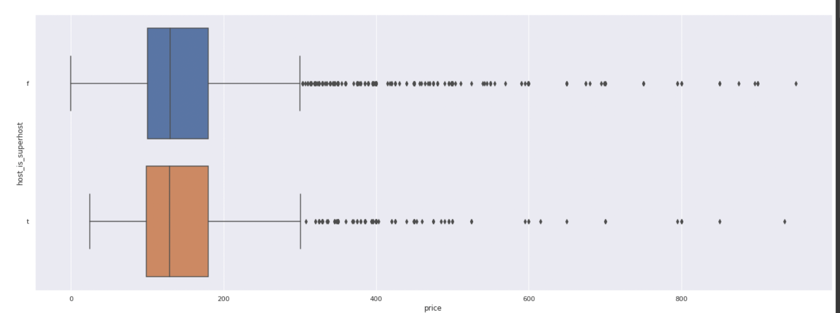
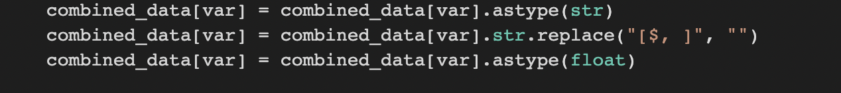
Numeric Data (Price)
Remove dollar sign $
Remove extreme values

Slide 13
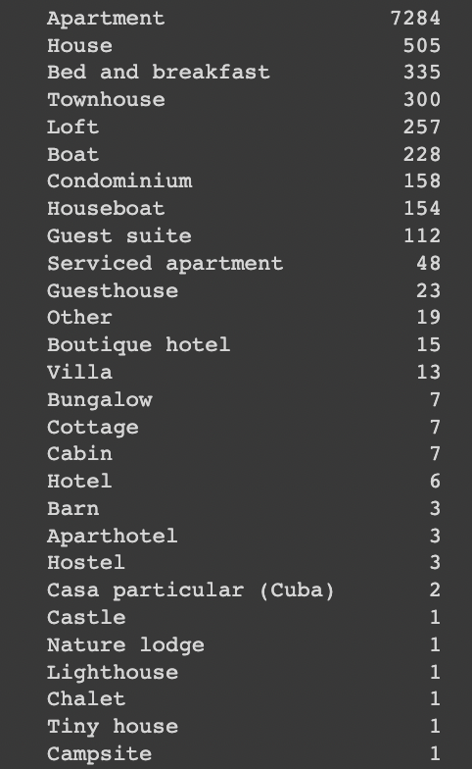

Categorical Data
Remove NULL/NAN values
Remove categories with low counts

Slide 14
03
Core Analysis
Notes:
In this section, we will go into our core analysis. Here, we will explain what we did and how they answer the questions we posed.

Slide 15
Q1
What is a reasonable rent for a particular listing?

Slide 16
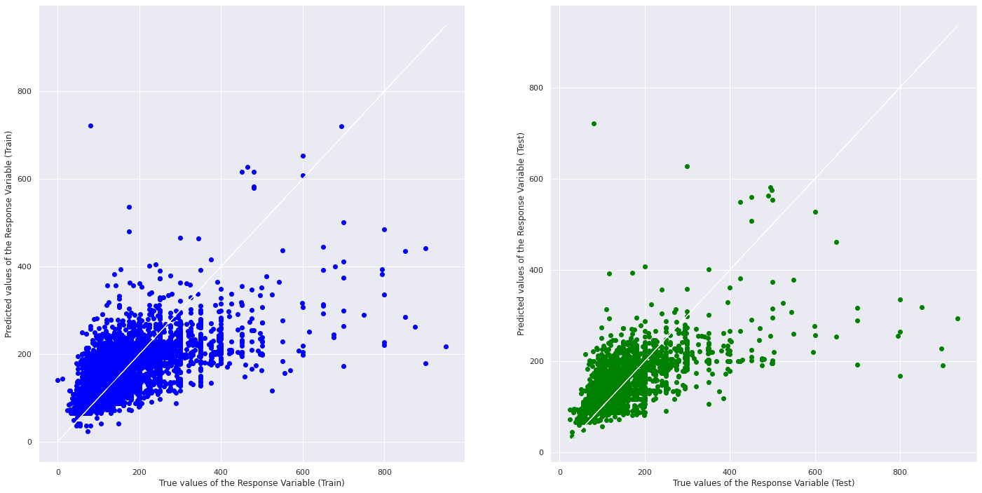
Linear Regression to Predict Price
Notes:
If you used ML (regression, classification, or something else); mention mainly WHICH one(s).
You may now briefly CLARIFY why and how the ML problem(s) aim(s) to solve your objective.
How did you apply ML technique(s) to SOLVE your problem? Which model(s), how and why?
Did you only use tools and techniques learned in this course? What ELSE did you learn / try?
also explain
MSE
R^2 (must we explain differences in R^2 across models?)

Slide 17

Random Forest Regression to Predict Price

Slide 18
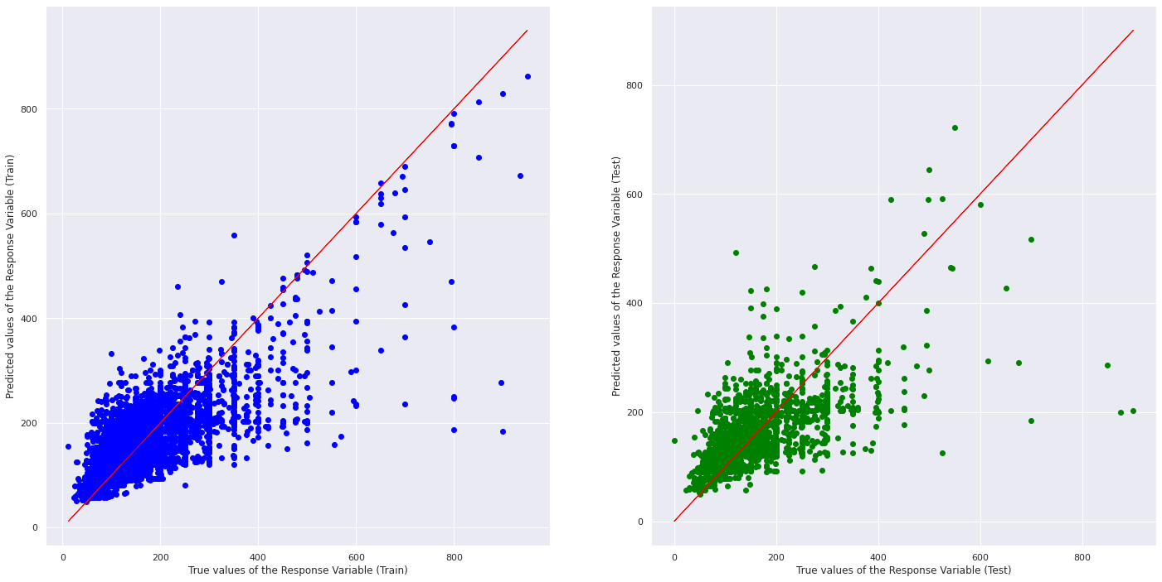
XGBoost to Predict Price

Slide 19
Q2
What is the ideal area for listings?

Slide 20
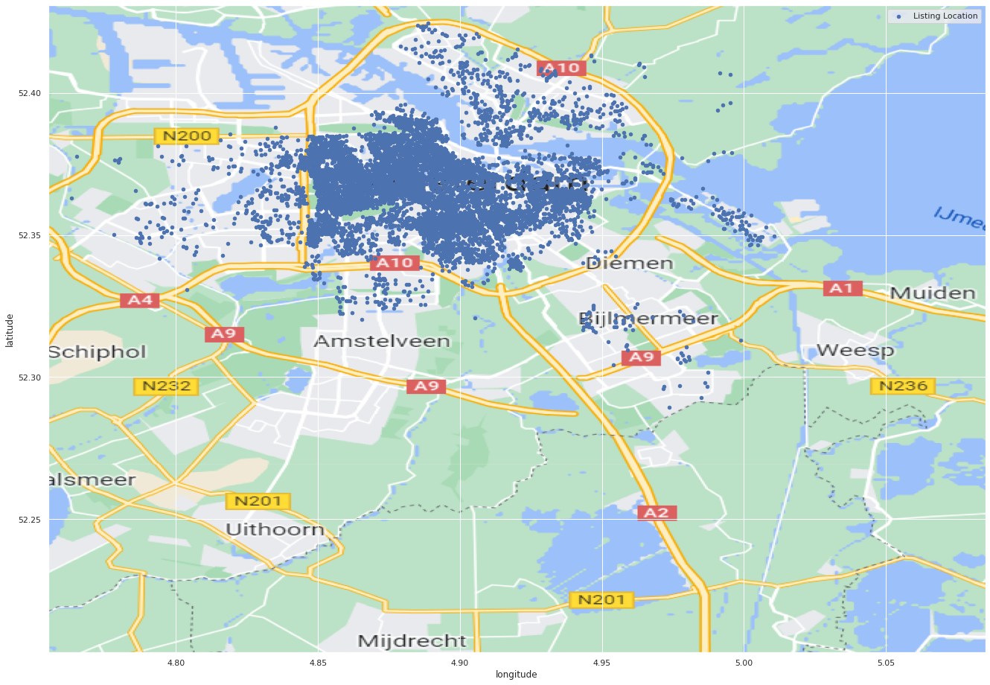
Using Folium function to display location

Slide 21
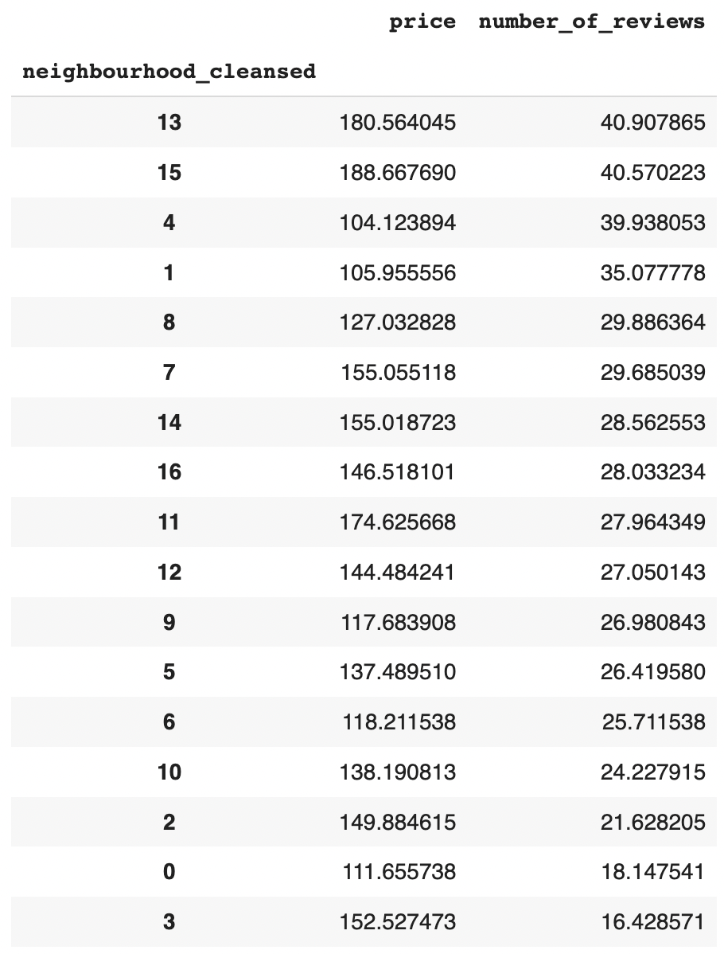
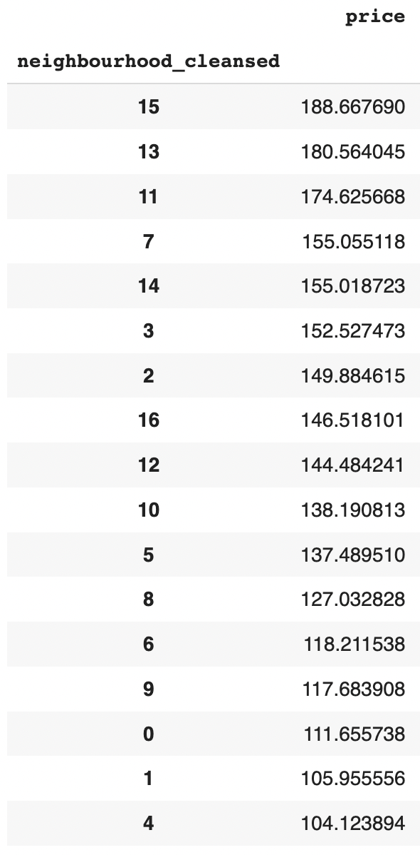
Groupby function to sort neighbourhoods
Table sorts neighbourhoods by decreasing number of reviews and price respectively
Area 13: Centrum-Oost
Area 15: Centrum-West

Slide 22
Q3
What factors affect the number of bookings?
-
Notes:
Our third question aims to find out what factors affect the number of bookings, and hence the popularity of a listing.

Slide 23
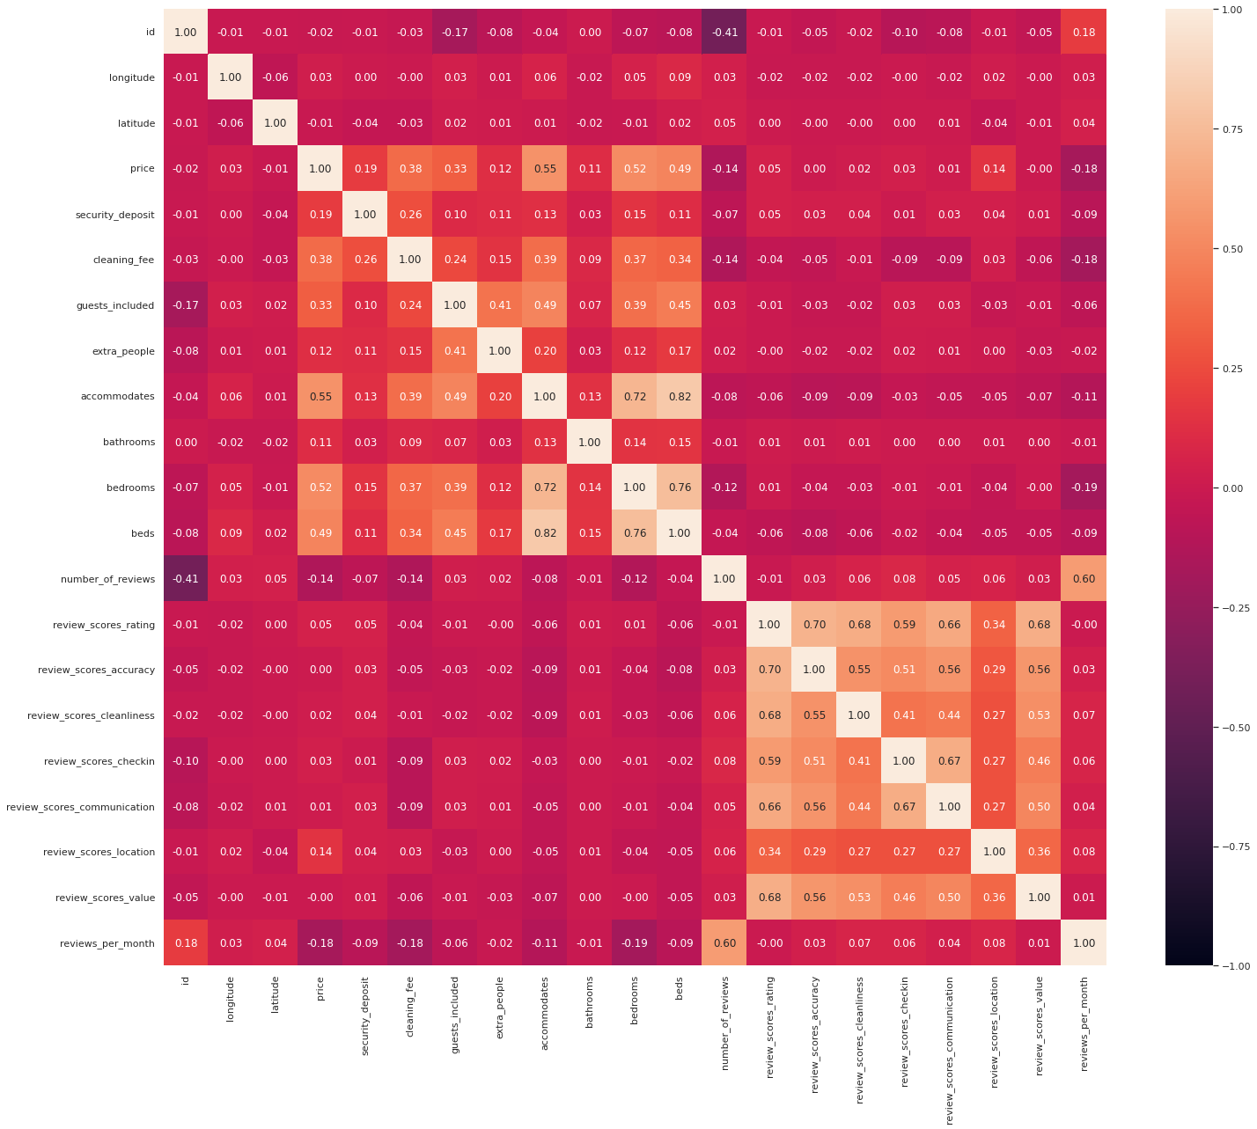
Analysis of Correlation with numeric vars
Heatmap plot of correlation between number of reviews and other variables is not very insightful
Notes:
We found the correlation between number of reviews and numeric variables. Nothing here shows a high correlation with number of reviews except "reviews per month", which does not give us any insight. Instead, we looked into categorical variables

Slide 24
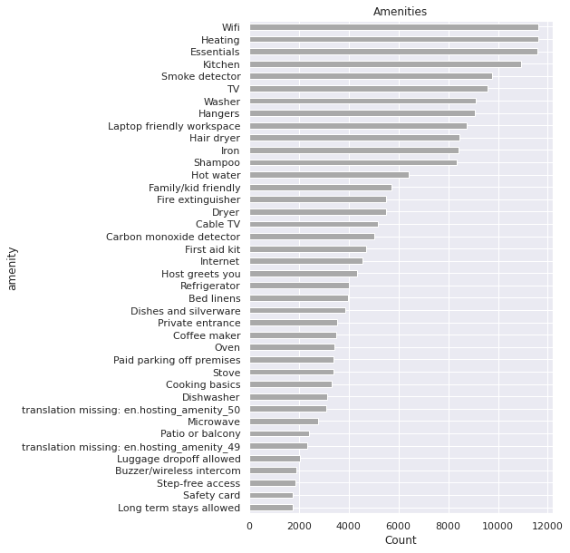
Counter to count the number of amenities
Counts the frequency of occurrence of amenities in all Airbnb listings
Host can use this chart to decide on what to include in their Airbnb
Notes:
We looked under the amenities column and ran a count of the frequency of which each amenity was provided.
LMAO WAIT this doesnt even have anything to do with number of bookings or popularity of listing

Slide 25
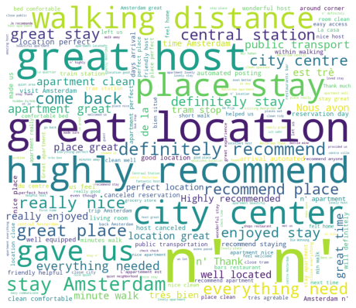
Customer Reviews
Laura Patt
“He is a great host with great location, would highly recommend”
We used WordCloud function to help identify words that come up often in reviews by guests
Hosts can capitalise on it to make their property more popular
Notes:
Using a separate dataset containing all the text reviews by guests, we used a wordcloud to identify words that often come up in reviews. These keywords suggest at factors that contributes to a listing's popularity. For instance, a good location seems to be important to airbnb guests. Hosts should get properties that are near the city center and within walking distance to amenities. A good host is also important to guests, so hosts should try their best to be friendly and accomodating. By making use of this data, an airbnb host can make their property more popular.

Slide 26
Q4
What ratings would a listing get?
Notes:
imma just copy haoguang's script here LOL abt the mse and r^2

Slide 27
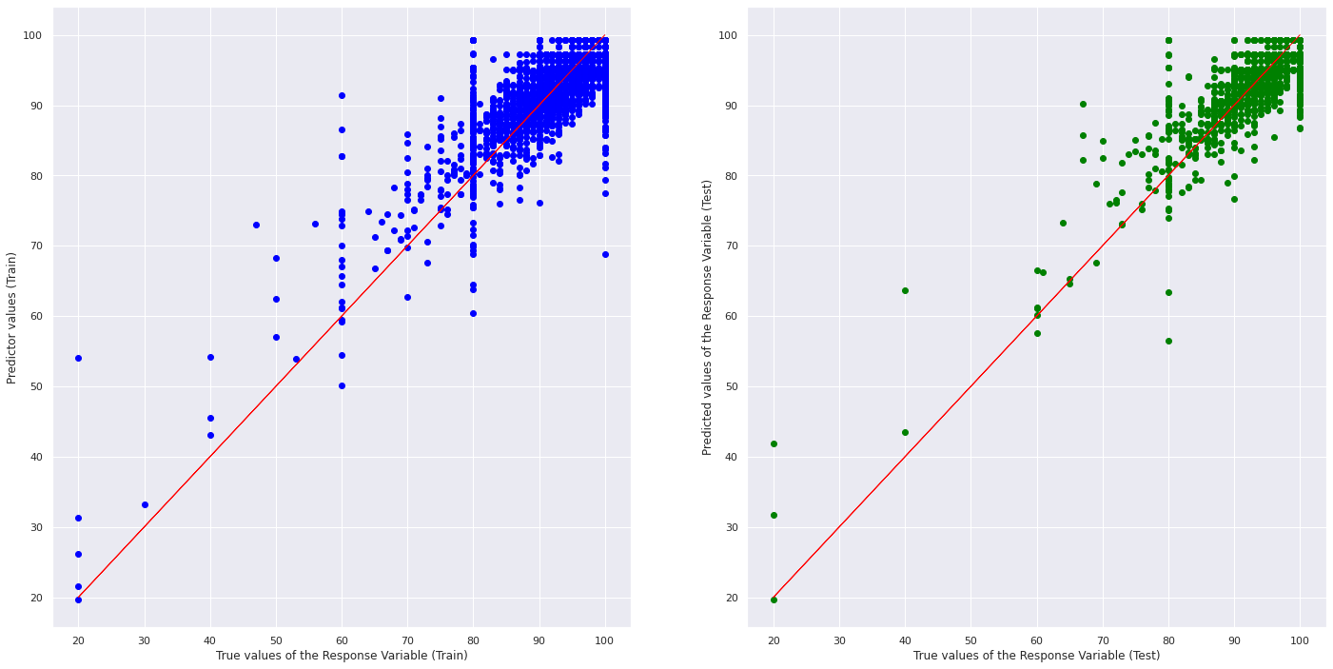
Linear Regression to Predict Ratings

Slide 28
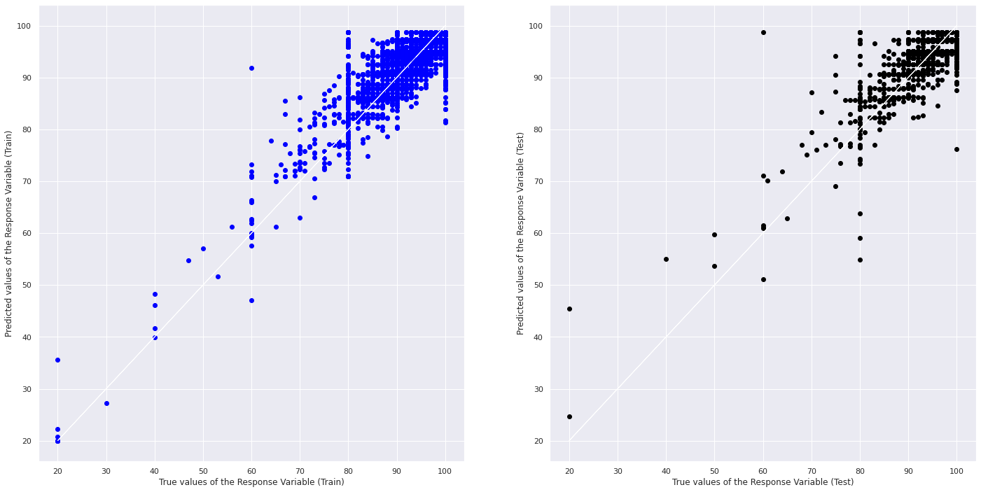
Random Forest Regression to Predict Ratings

Slide 29
04
Conclusion
Notes:
What is the OUTCOME of your project? Did it solve your original problem? Anything interesting?
What are your data-driven INSIGHTS and recommendations / views towards the target problem?

Slide 30
Project Outcome and Insights
An airbnb host now knows
how to price their listing;
where best to put up a listing;
how to make their property more popular; and
how to get high ratings with their listing
Notes:
We want an airbnb host to be able to make the most of their property and ensure that their listings are successful. From our project, we have a few suggestions for them. Firstly, based on the characteristics of their property, they should be able to predict a typical price of a similar property and be able to price their property appropriately.
Second, for a host looking to put up a listing in Amsterdam, some of the best areas to put up listings will be "Centrum-Oost" and "Centrum-West". These areas are the most popular and also fetch the highest prices. However there are also the most listings in these areas. If they wish to offer a listing in somewhere with less competition, "Oud-Noord" would be a good choice, ranking relatively highly in popularity and price. They should avoid regions like "Geuzenveld - Slotermeer" as it ranks very poorly in both price and number of reviews.
Thirdly, the location of the listing is extremely important to guests. To make sure their listing is popular, they should get properties that are near the city center and within walking distance to amenities. A good host is also important to guests.
Finally, they will also be able to predict how high a rating they would get based on the characteristics of their property and possibly aim to improve it.

Slide 31
Thanks
Please keep this slide for attribution

